Slide 1
Transforming Donation: An Online Solution for a Contactless Future

Slide 2
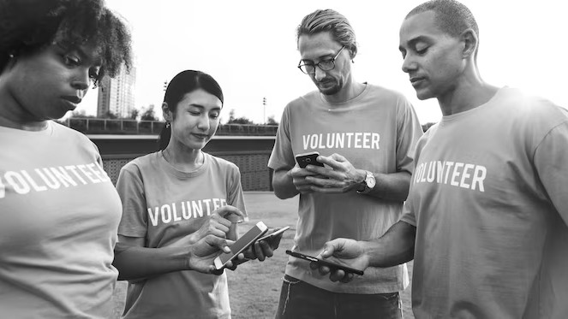
Transforming Donation: An online solution for a contactless future.
In a world where social distancing is the new norm, online donation has become a
necessity. This presentation will discuss how technology can be used to make
donations more accessible and convenient.

Slide 3

Current Challenges:
Traditional donation methods are becoming obsolete. The pandemic has highlighted the need for contactless donation methods. Online donation
platforms need to be user-friendly, secure, and accessible to everyone.

Slide 4
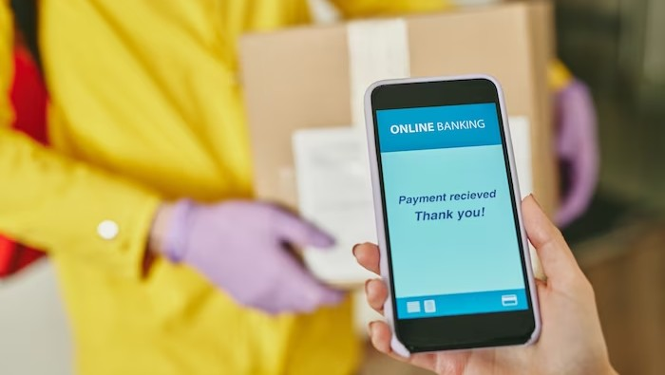
The Solution:
Online donation platforms can help organizations reach a wider audience. They can be designed to be user-friendly, secure, and accessible to everyone. Features such as recurring donations, social media integration, and mobile optimization can make the process more convenient for donors.

Slide 5
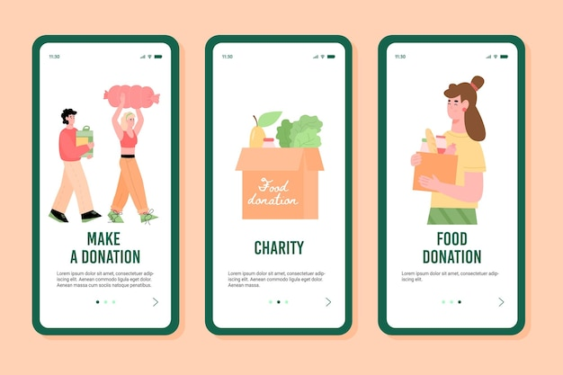

Slide 6


Cloth donation is a valuable and impactful form of philanthropy that can bring significant benefits to both recipients and society as a whole. Here are some important aspects of cloth donation:
Helping Those in Need
Promoting Dignity and Confidence:
Reducing Environmental Impact

Slide 7
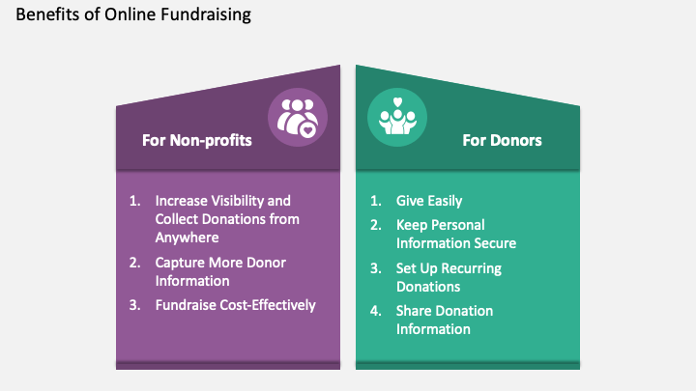

Slide 8

Thanks!

